Slide 1
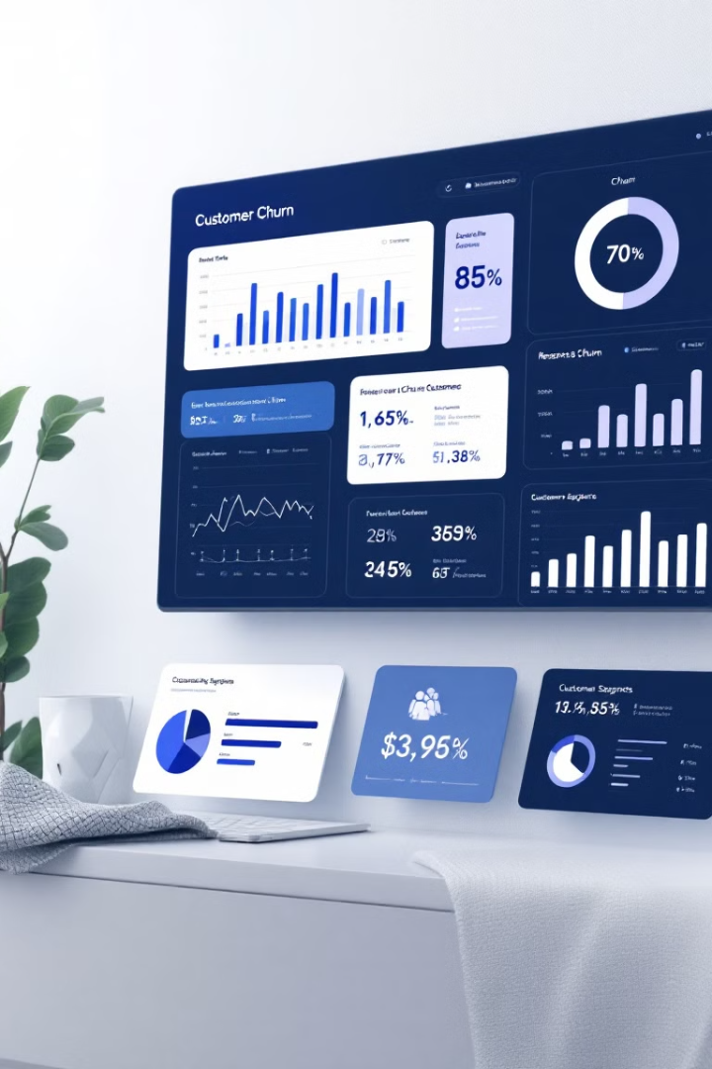
Customer Churn Analysis: Insights and Trends to Drive Retention Strategies
Welcome to our customer churn analysis presentation. We'll explore key insights and trends to help drive effective retention strategies for our business.
CJ
by Chinonso Jinwa

Slide 2

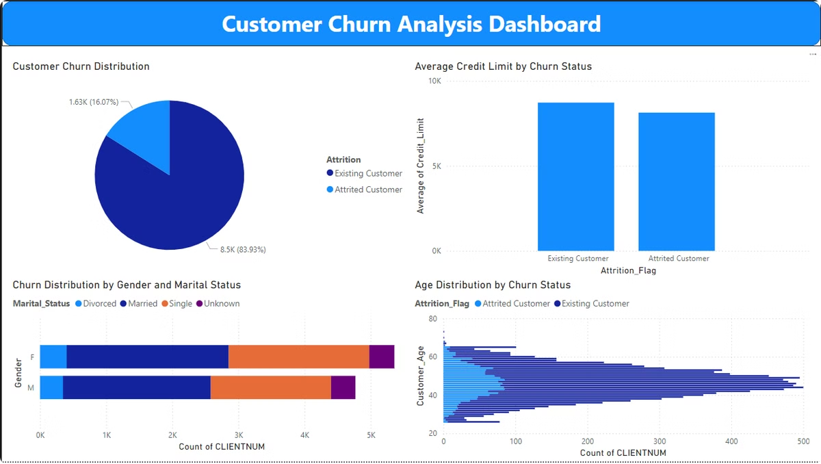
Customer Churn Analysis Dashboard
Comprehensive Overview
Key Metrics at a Glance
Our dashboard provides a holistic view of customer churn patterns and metrics.
Easily track churn rate, customer demographics, and retention factors.
Data-Driven Decisions
Use these insights to inform targeted retention strategies and improve customer loyalty.

Slide 3

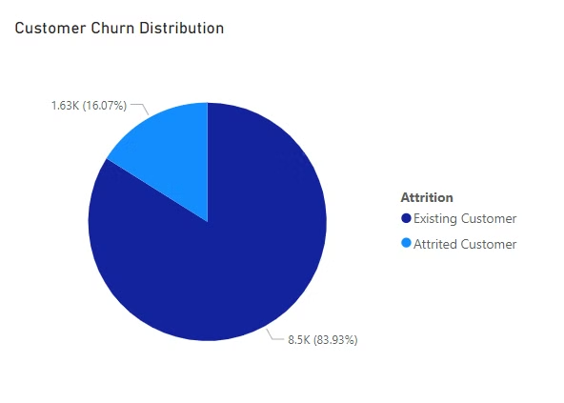
Customer Churn Distribution
16.07%
83.93%
Churn Rate
Active Customers
Representing 1,630 customers who have left our services.
8,500 customers remain loyal to our brand.

Slide 4
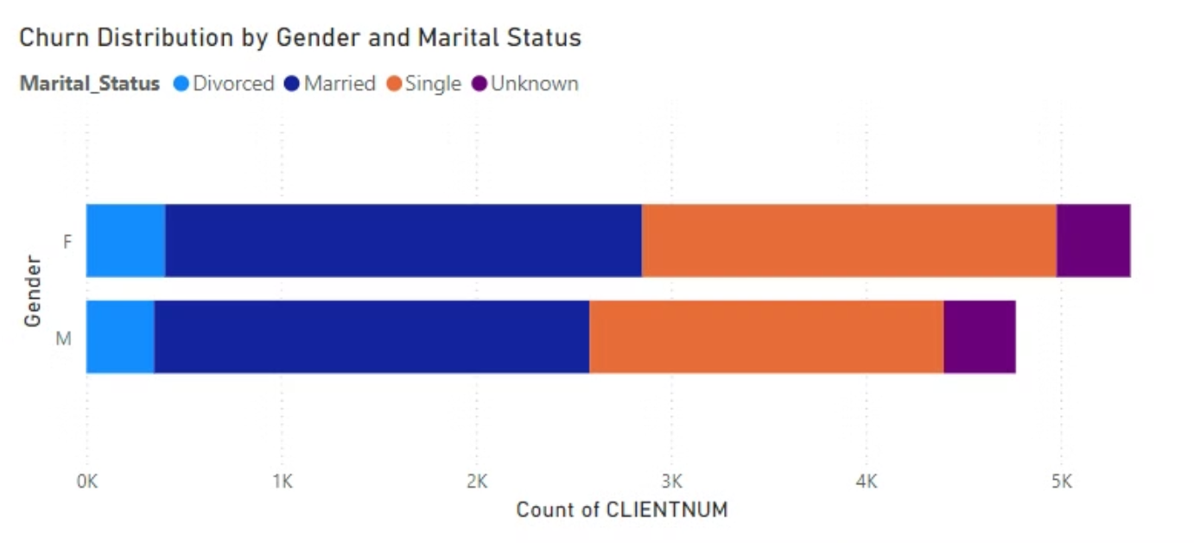
Churn Distribution by Gender and Marital Status
Married Customers
Single and Divorced
Form the largest customer segment, showing lower churn rates overall.
Exhibit slightly higher churn rates, indicating a need for targeted retention efforts.

Slide 5

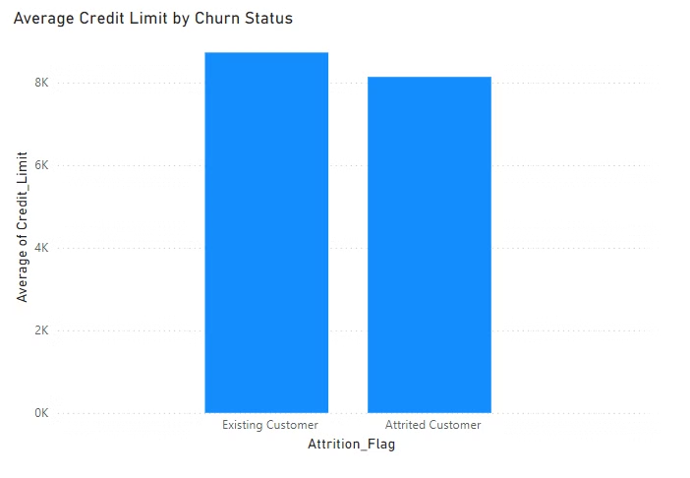



Average Credit Limit by Churn Status
Lower Credit Limits
Churned customers have an average credit limit of ~$8,000.
Potential Link
Lower credit limits may contribute to customer disengagement.
Action Required
Consider credit limit adjustments to improve retention.

Slide 6
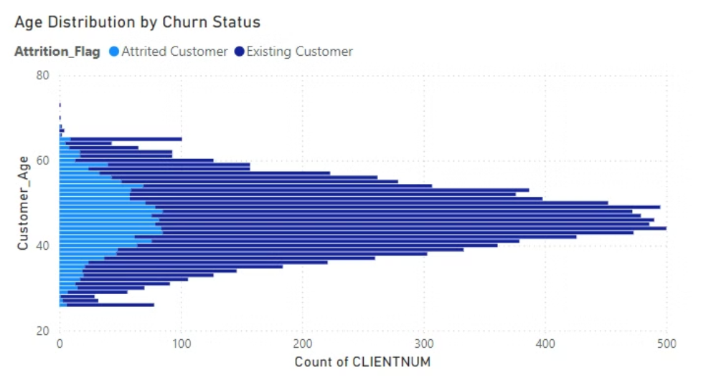



Age Distribution by Churn Status
40-60 Years
1
Dominant age range in both churned and active groups.
2
Retention Focus
Target this age range for improved retention efforts.
3
Tailored Strategies
Develop age-specific retention campaigns and services.

Slide 7

Recommendations for Retention
1
Targeted Retention Strategies
Focus on middle-aged customers and address credit limit concerns for high-risk groups.
2
Enhanced Engagement
Develop campaigns for single and divorced customers. Offer personalized financial solutions.
3
Improve Customer Experience
Use transaction patterns to identify disengagement. Implement feedback loops for concerns.

